Slide 1

Developing Device Drivers in Rust
Presenting
School of Computing, Engineering & Physical Sciences
BSc (Honours) Computing Science
Supervisor: Paul Keir
Moderator: Stephen Devine

Slide 2

Device Drivers t h e f r a g i l e
Image: David Carson

Slide 3
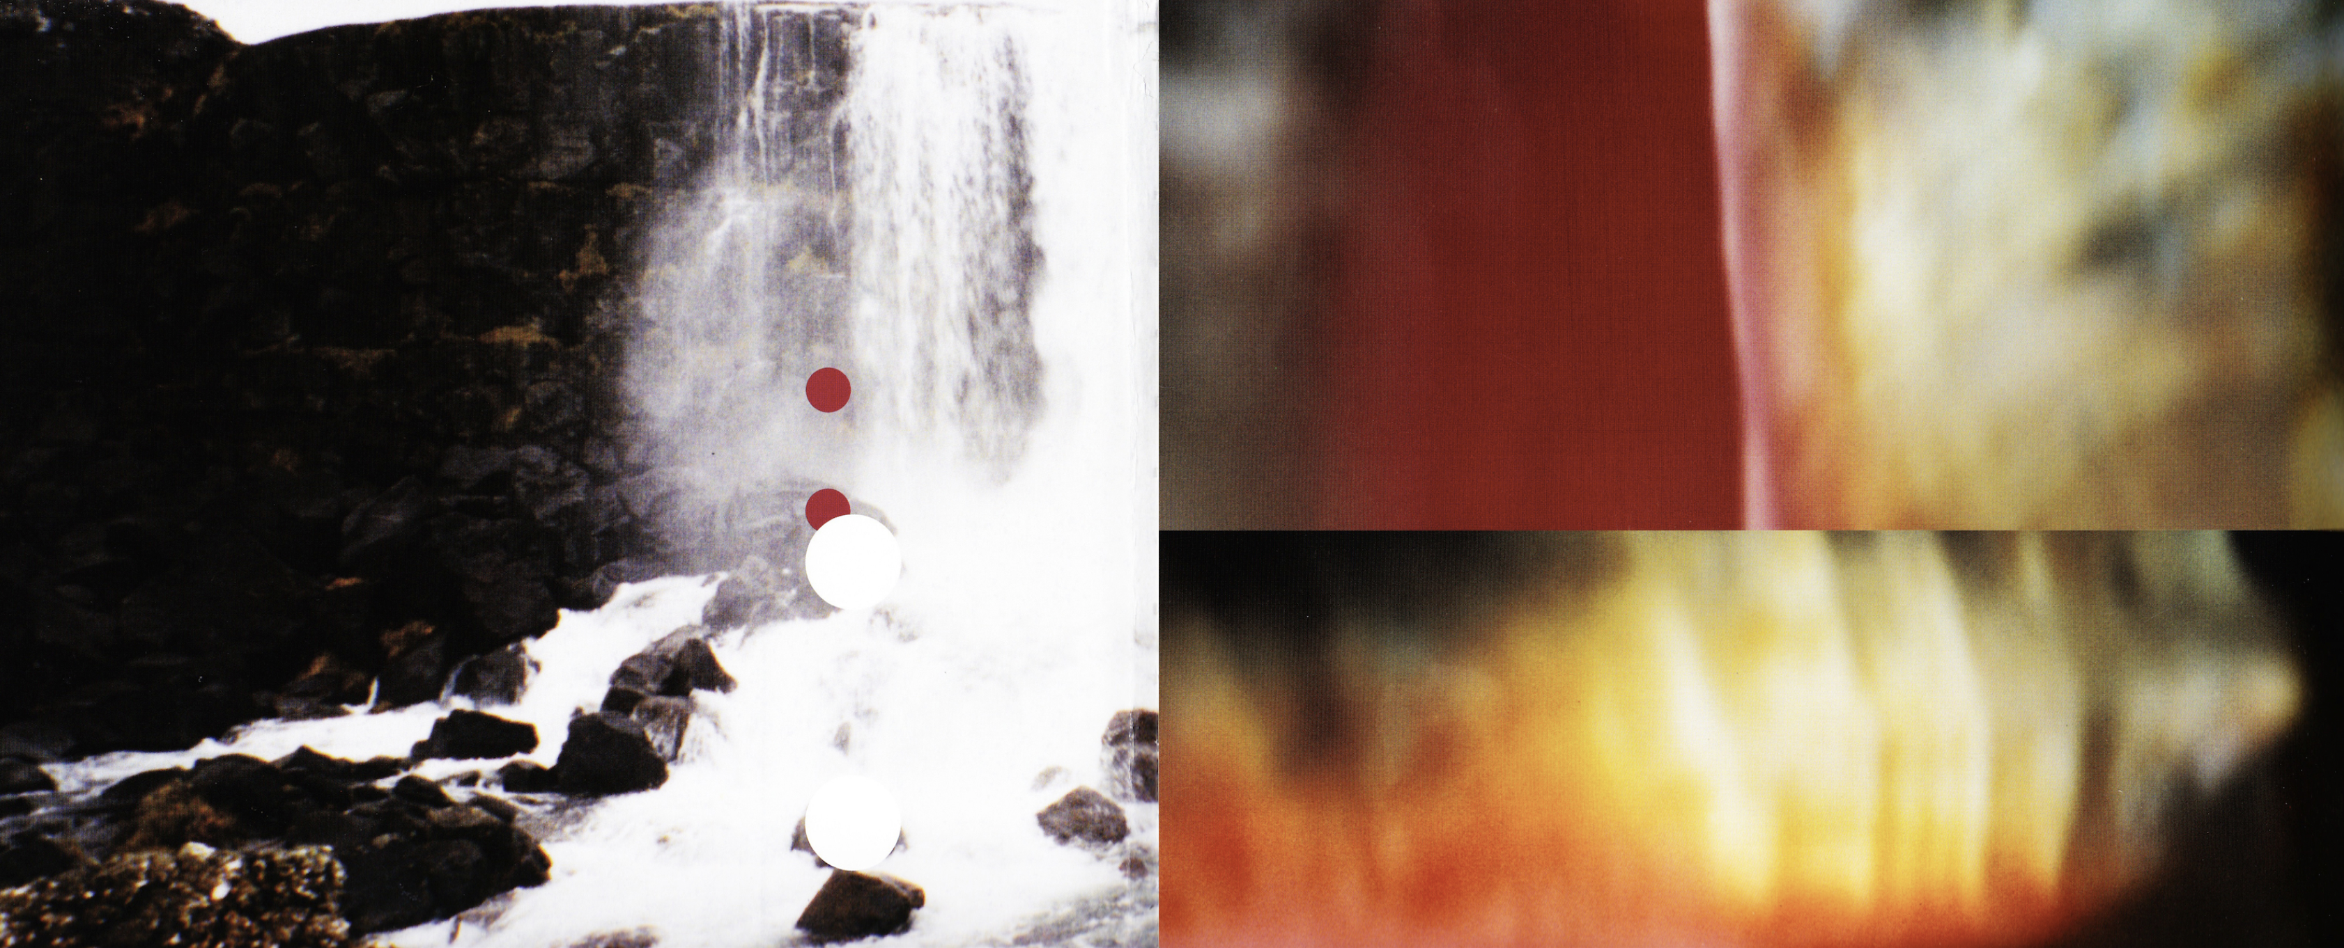
Device drivers
Problems
Control peripheral devices – interact with underlying hardware.
Provide extensions to the Operating System.
A necessity that suffers from a range of issues with potentially dangerous consequences.
Continue to be written in C.
Originally developed 1969-1973.
Suffers from issues with memory safety.
Memory safety can lead to critical vulnerabilities - mostly present in C, C++ and Assembly
Image: David Carson

Slide 4

P r o j e c t a I m
Overcome previously described
issues by developing a Linux
device driver in r u s t.
Image: David Carson

Slide 5
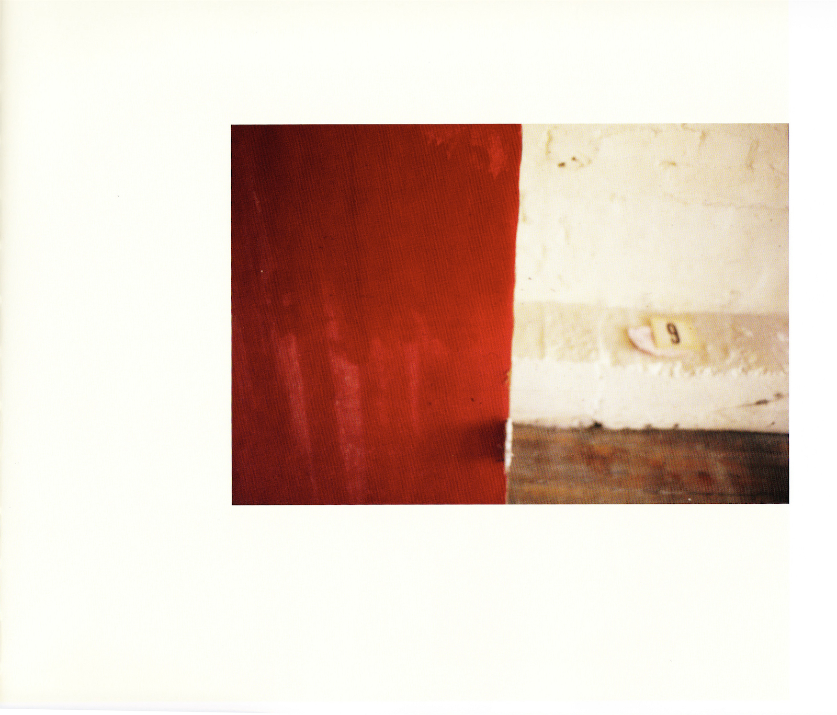
R u s t
rust for Linux
2019, Miguel Ojeda
introduce a new system programming language into Linux kernel
memory safe language
strong compiler
borrow system
variable lifetimes
Stroustrups criticism
“every safe language, including rust, has loopholes allowing unsafe code”

Slide 6
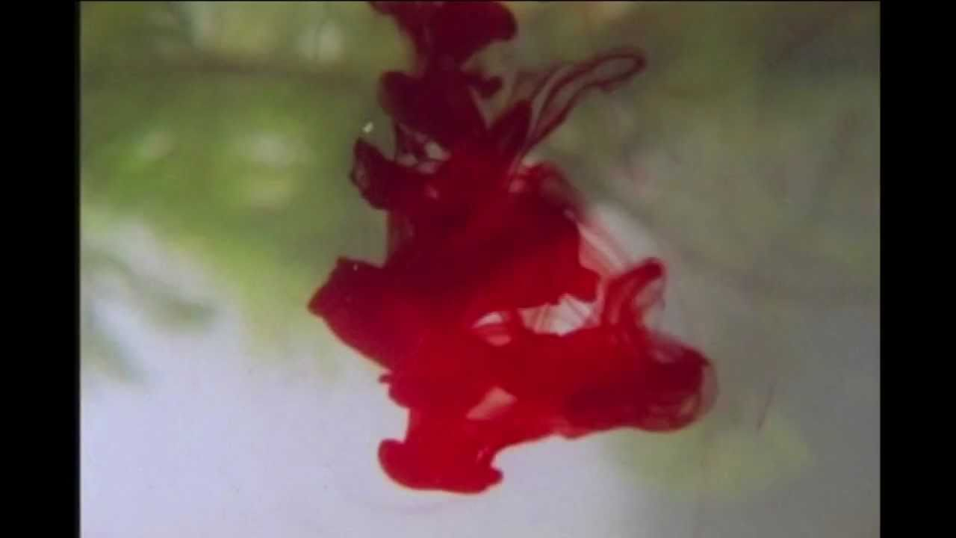
Memory safety
Accessing memory typically outside the bounds of a data structure which then provides a vector to attack from to conduct further exploitation/attack.
Android | >65% of High & Critical security bugs
Android (bluetooth & media components) | 90% of vulnerabilities
IOS 12 | 66.3% of all vulnerabilities
MacOS Mojave | 71.5% of all vulnerabilities
Chrome | ~70% of serious security bugs
Microsoft | ~70% of CVE vulnerabilities
Firefox (CSS subsystem) | 73.9% of bugs
Ubuntu kernel | 65% of CVEs (In security updates between November and May 2020)
Each statistic is that of a large code base containing millions of lines of code.
All are written in C or C++.
Includes;
Use-after-free
Double-free
Heap Buffer overflow
Integer overflow
Out-of-bounds read
Out-of-bounds write
(Alex Gaynor, 2020)
Image: David Carson

Slide 7
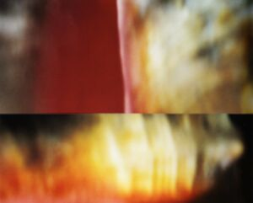
Image: David Carson

Slide 8
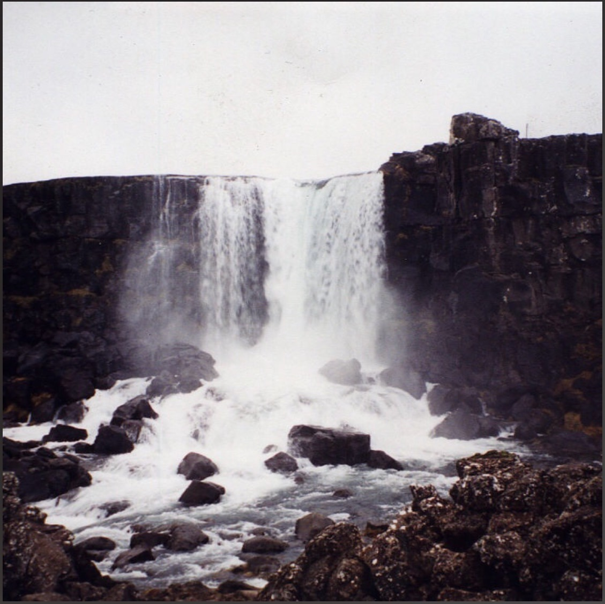
the great below
(progress)
(development)
(findings)
Industry input has informed development and other aspects of project.
Alex Gaynor
Miguel Ojeda
Jonathan Blow
Have enabled Rust support on Linux 6.1 Machine.
USB support is under development within RFL.
Not all kernel subsystems are implemented.
Conclusion seems to be that the project is still quite young but has a bright future.
Demo: compilation & execution of ‘Hello, World’ in a Rust driver.
Google & Android 13
Significant drop in memory safety vulns & severity.
Now 35% of total Android vulns (previously 76%).
Rust adopted in Android 12 as alt to C/C++.
0 memory safety vulnerabilities in Android Rust code.
Exo-kernel
Remove as many hardware abstractions as possible.
Allow the application to control its own memory resources.
Paging, Scheduling, Context, Faults.
Improve performance, efficiency, development, testing.
Image: David Carson

Slide 9


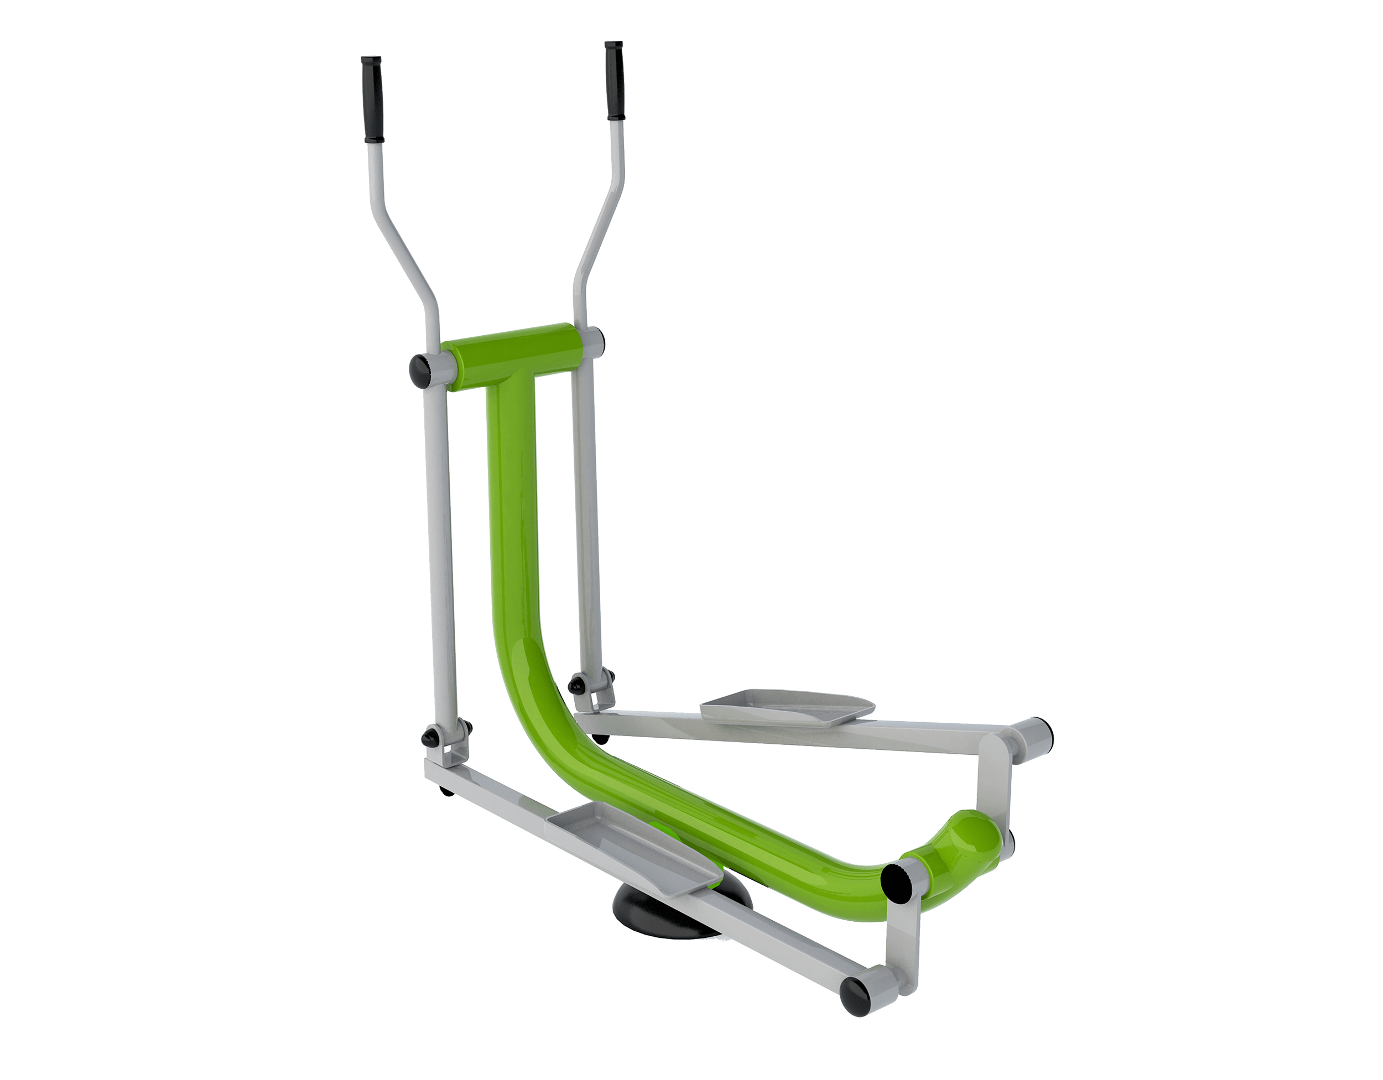
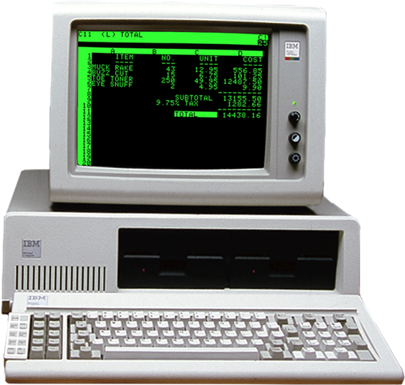
Enabling Rust support on Linux (6.1 and beyond)
Recompile your existing kernel to Linux 6.1+.
Recompile this new 6.1 kernel with Rust enabled.
Enjoy your new Rust-y kernel!
Install and configure Rust
Image: David Carson

Slide 10
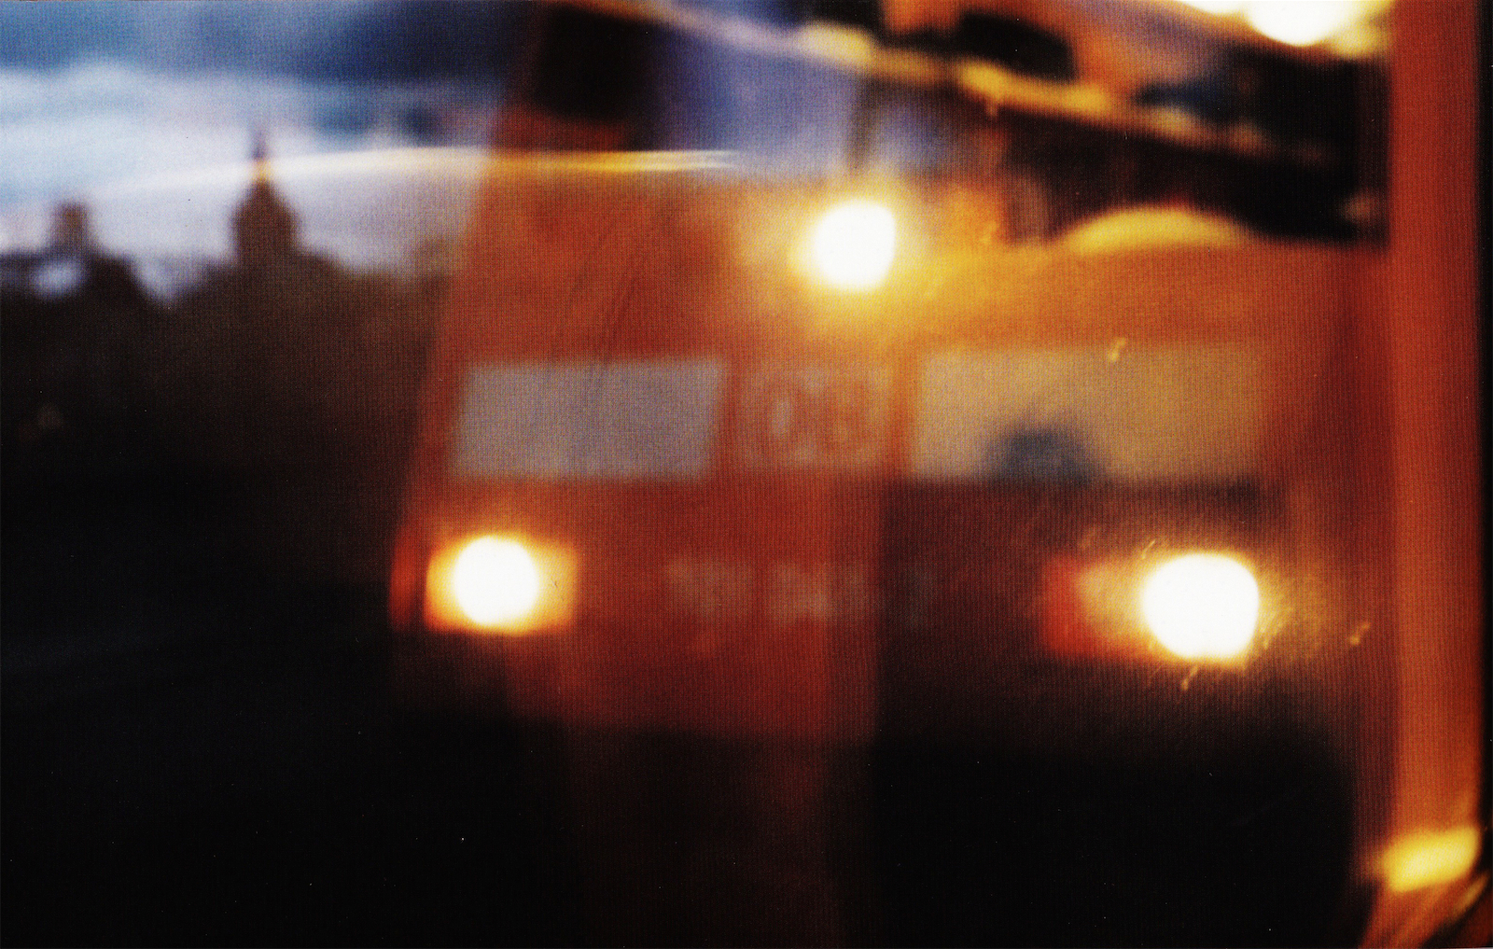
Image: David Carson

Slide 11
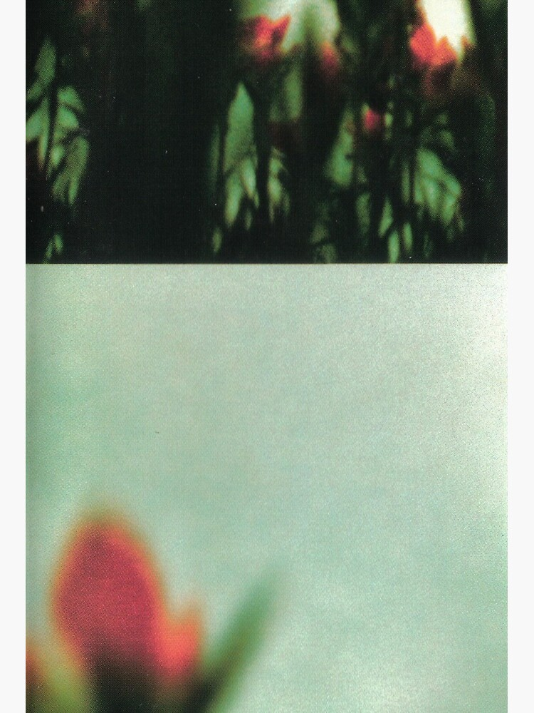
underneath it all
these slides inspired by ‘The Fragile’ by Nine Inch Nails
images credited to David Carson/Nine Inch Nails
Kyle Christie University of the West of Scotland [2023]
Image: David Carson

